Slide 1

Housing prices
TEAM#4
Vincent Wai Yeung Tsui
Raymon Matiling
Jeffrey Che
Nadine Blaik

Slide 2

How has the housing market’s prices changed since 2008 and can our model predict accurately its progress?

Slide 3
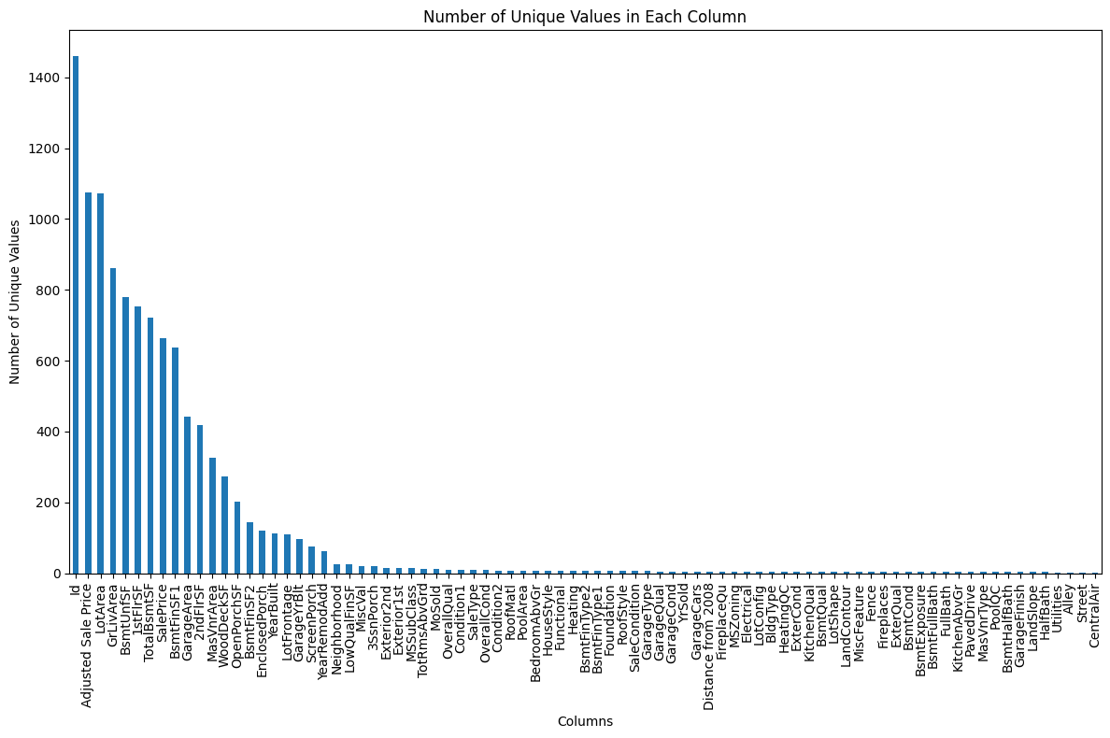
Exploring the Diversity of Data: Visualization of Unique Values in Each Column
This provides a comprehensive overview of the uniqueness present within each column of our dataset. Each bar represents a specific column, with its height indicating the count of unique values within that column. The descending order of bars facilitates easy identification of columns with the highest and lowest numbers of unique values. Taller bars signify greater diversity, suggesting a wide range of distinct values, while shorter bars indicate less variation. This visualization offers valuable insights into the richness and complexity of our dataset, guiding subsequent analysis and decision-making processes.
Notes:
As we delve into the intricacies of our dataset, it's essential to understand the breadth and richness of the values present in each column. Our visualization offers a comprehensive overview, with each bar representing a specific column and its height reflecting the count of unique values within that column. This arrangement allows us to easily discern the extent of diversity across our dataset.
Upon examining the graph, we observe columns with taller bars, signifying a high level of diversity and a wide range of unique values. Conversely, columns with shorter bars indicate lower diversity and fewer distinct values. This insight is invaluable as it provides us with a deeper understanding of the complexity inherent in our dataset.
Understanding the diversity of our data holds significant implications for our analysis and decision-making processes. It informs our approach to feature selection, guiding us in identifying and prioritizing the most relevant variables for our analyses. Additionally, it shapes our data preprocessing techniques, enabling us to effectively handle the diverse range of values present in our dataset.

Slide 4
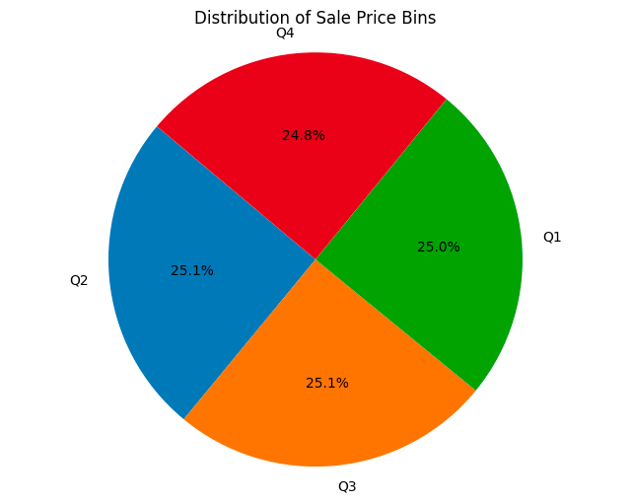
Exploring Sale Price Distribution: Quartile-Based Categorization
This graph illustrates the distribution of sale price bins within our dataset, categorized based on quartiles.
The dataset is divided into four quartiles: Q1, Q2, Q3, and Q4, each representing different ranges of sale prices. The pie chart visually represents the proportion of sale prices falling within each quartile, with each slice indicating the percentage of data within that range.
This visualization offers a clear understanding of how sale prices are distributed across the dataset, providing insights into the variability and distribution of prices.
Notes:
To provide a structured understanding of sale prices, we categorized them based on quartiles, dividing them into four distinct bins: Q1, Q2, Q3, and Q4. These quartiles allow us to segment the data into equal portions, each representing a different range of sale prices.
Now, let's turn our attention to the pie chart displayed on the slide. This chart beautifully illustrates the distribution of sale price bins, with each slice representing a specific quartile. The size of each slice corresponds to the proportion of sale prices falling within that quartile.
As you can see, the pie chart offers a visual representation of how our sale prices are distributed across the quartiles, providing valuable insights into the variability and distribution of prices within our dataset.

Slide 5
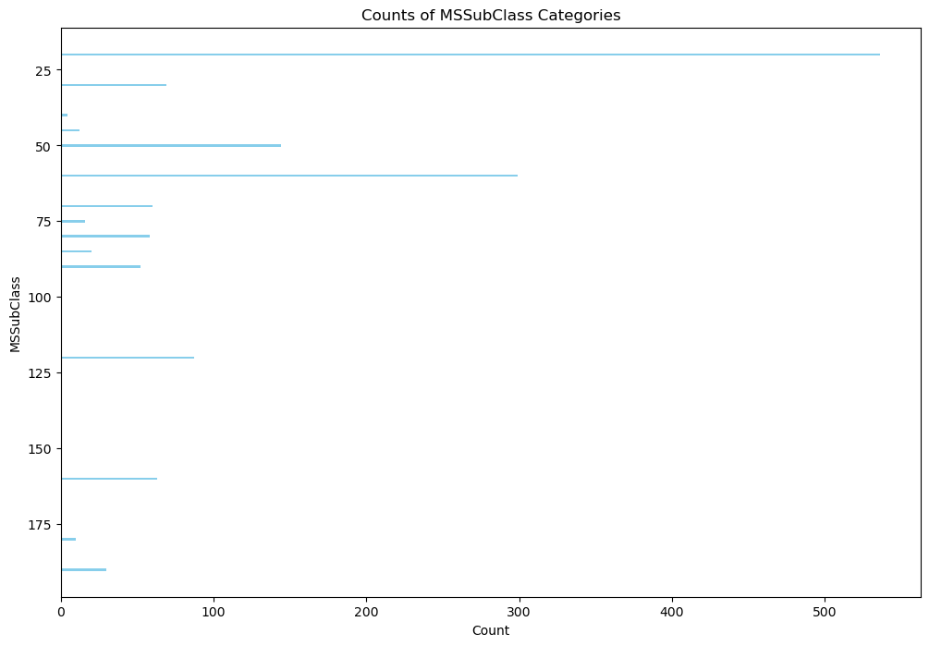
Analyzing Property Types: Distribution of MSSubClass Categories
This graph illustrates the distribution of various property types categorized by MSSubClass within our dataset.
Each horizontal bar represents a specific MSSubClass category, while the length of the bar corresponds to the count of properties belonging to that category.
By examining this visualization, we gain insights into the prevalence of different property types and their relative frequencies within the dataset.
Notes:
As we delve into the graph displayed before us, we witness a visual representation of the prevalence of different property types within our dataset.
Each bar signifies a specific MSSubClass category, with its length reflecting the count of properties falling under that category. This insightful visualization enables us to understand the distribution of property types and their relative frequencies, shedding light on the diverse array of properties present in our dataset.
By analyzing this graph, we gain valuable insights that inform our understanding of property characteristics and aid us in making informed decisions.

Slide 6
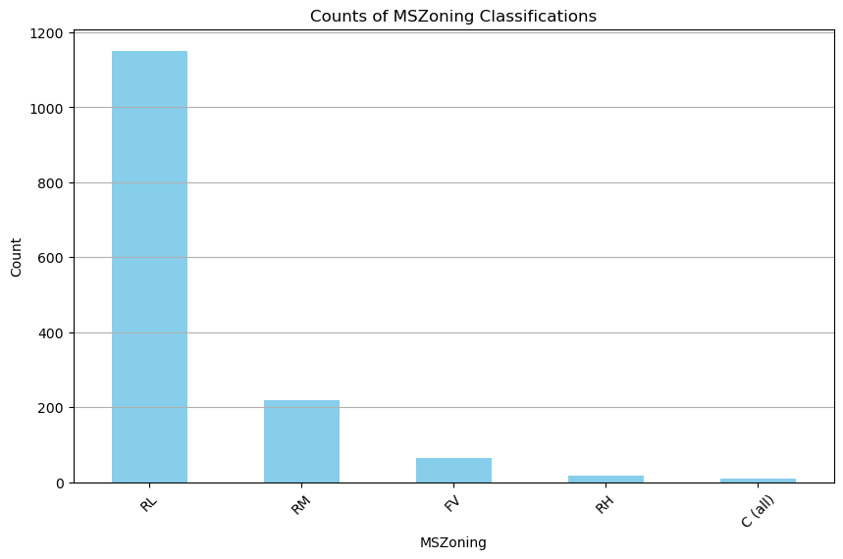
Exploring Zoning Classifications: Distribution of MSZoning Categories
This bar chart visualizes the distribution of properties based on their zoning classifications, as represented by the MSZoning categories within our dataset.
Each bar corresponds to a specific MSZoning classification, with the height indicating the count of properties falling under that category. By examining this visualization, we gain insights into the distribution and prevalence of different zoning classifications within our dataset.
Notes:
Each bar on the chart represents a specific MSZoning category, with its height reflecting the count of properties classified under that zoning.
This visualization offers valuable insights into the distribution and prevalence of zoning classifications within our dataset, empowering us to better understand the landscape of property zoning.
As we continue our analysis, let's leverage these insights to inform our decision-making processes and unlock further opportunities.

Slide 7
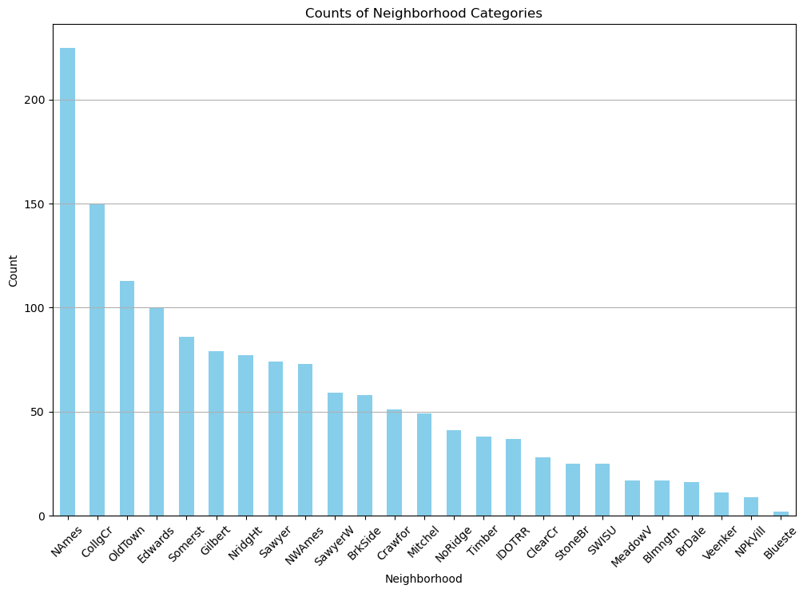
Exploring Neighborhoods: Distribution of Property Counts by Neighborhood
This bar chart illustrates the distribution of properties across different neighborhoods within our dataset. Each bar represents a specific neighborhood, with the height indicating the count of properties located in that neighborhood. By analyzing this visualization, we gain insights into the distribution and prevalence of properties across various neighborhoods, providing valuable information for understanding neighborhood demographics and property characteristics.
Notes:
Each bar on the chart corresponds to a specific neighborhood, with its height reflecting the count of properties located in that neighborhood.
This visualization offers us valuable insights into the distribution and prevalence of properties across various neighborhoods, providing us with a deeper understanding of neighborhood demographics and property characteristics.
By leveraging these insights, we can make informed decisions and gain a better understanding of the real estate landscape.

Slide 8

References

Slide 9

Q&A

